Slide 1
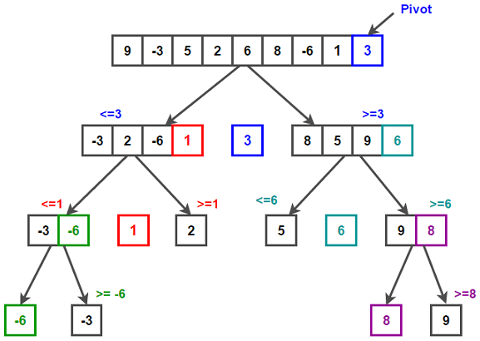
Standard Algorithms Sorting Algorithm 2: The Quicksort
Purpose | The quicksort algorithm can be used to sort an unordered list/array into ascending or descending order
Features | Divide and Conquer Quicksort is an example of a Divide and Conquer algorithm. This means it splits or breaks down a problem in order to solve it. To sort a list, the list is broken down into smaller lists, sorted and then put back together Pivot A pivot value is chosen as a comparison value to sort the data. Pivot choosing methods include: Left Most Element, Right Most Element, Median, Median of 3 Recursive The quicksort is usually recursive. This means it calls itself until the problem is solved (the list is sorted). See the algorithms on the next slide to see how this works
Advantages | Very efficient sorting algorithms for large sets of data Out performs other standard sorting algorithms on average (in most cases) Doesn’t require much additional storage space to run In the worst case scenario it is only as efficient as other sorting algorithms
Disadvantages | Efficiency of the algorithms reduces significantly for lists that are close to already being sorted Efficiency decreases significantly if a poor choice of pivot is used

Slide 2
The Quicksort Example: -Using a median pivot element
STEP 1: Input an unsorted list/array or data collection
STEP 2: Choose a pivot – the median value which in this case is also the Left Most Element (LME), to begin with. Pivot = 3
3 | 2 | 5 | 1 | 4 | -1 | 6
STEP 3 - Divide: Starting from the left, place all the elements < pivot into a list (on the left) and place all elements > pivot into a list (on the right)
2 | 1 | -1 | 3 | 5 | 4 | 6
STEP 4 – Divide and Conquer: Repeat the process for the left and right list (This can be done simultaneously as the algorithms is recursive and not iterative)
Remember the new pivots should be the median values and should be in the highlighted boxes if you have worked it out correctly – i.e. they will be underlined in step 3
-1 | 1 | 2
4 | 5 | 6
STEP 5 - Rebuild: Repeat the process for the left and right list (This can be done simultaneously as the algorithms is recursive and not iterative)
-1 | 1 | 2 | 3 | 4 | 5 | 6

Slide 3
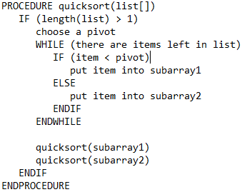
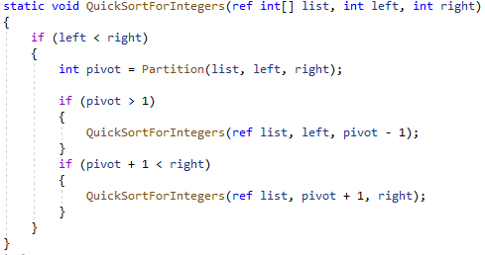
Standard Algorithms Sorting Algorithm 2: The Quicksort
Example Pseudocode for: Quicksort | Example C# instructions for: Quicksort
 | In this example the Partition is function is used to choose a pivot and move the elements. It should make sense when programmed
Stages of a Quick Sort Input an unsorted list Choose a pivot Divide: Put elements less than (<) the pivot into a list (to the left of the pivot) Divide: Put elements that are greater than (>) the pivot into a list (to the right of the pivot) Divide & Conquer: Repeat the process (recursively by calling itself) Rebuild: Put the list back together | Efficiency and pivot choice The quick sort algorithm is most efficient/effective when it uses a pivot that is the middle value in the list – You will see why this when you complete the bronze questions. Methods of choosing a pivot Left Most Element Right Most Element Median Median of 3 Remember any calculations needed to choose a pivot requires processing time

Slide 4
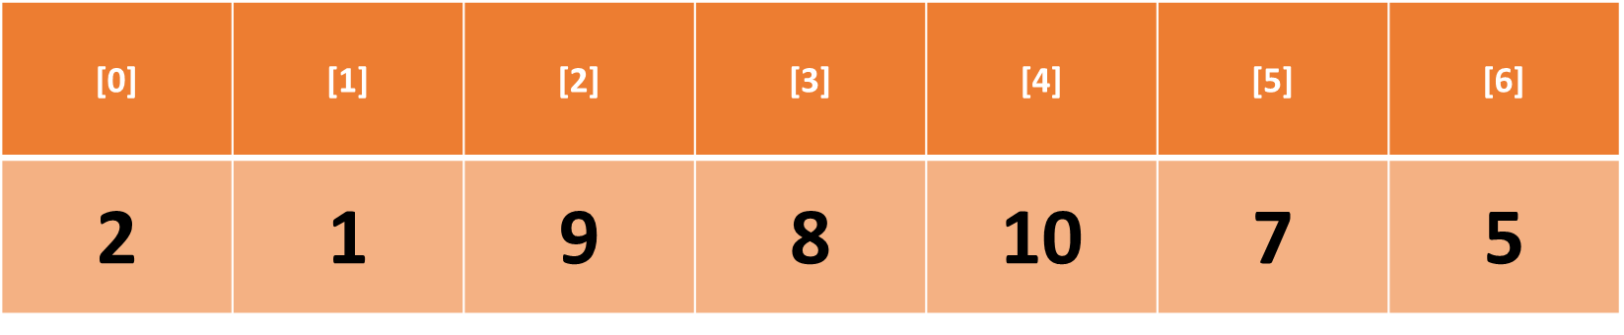
Bronze 1
Exam Questions
Demonstrate how a quicksort algorithm would sort the array shown above using the a median element based pivot Write below [5 mark]
STEP 1/2 – Choose the Pivot 7 STEP 3 – Divide – Starting from the left of the list, move the elements < the pivot into a new list on the left of the pivot and move the elements > the pivot into a new list to the right of the pivot 2, 1, 5, 7,9, 8, 10 STEP 4 – Divide and Conquer – Recursively, repeat the process for the new lists pivot = 2 Pivot = 9 1, 2, 5 8, 9, 10 STEP 5 – Rebuild – Rebuild the list using the smaller lists that have now been sorted 1, 2, 5, 7, 8, 9, 10

Slide 5
Bronze 2
Exam Questions
Demonstrate how a quicksort algorithm would sort the array shown above using the right most element (RME) approach Write below [7 mark]
Step 1/ 2 2, 1, 9, 8, 10, 7, 5 5 Step 3 2, 1, 5, 9, 8, 10, 7 Step 4 2, 1, 5, 9, 8, 10, 7 1 1, 2 7 7, 9, 8, 10 7, 8, 9, 10 Step 5 1, 2, 5, 7, 8, 9, 10

Slide 6
Bronze 3
Exam Questions
Demonstrate how a quicksort algorithm would sort the array shown above using the left most element (LME) approach Write below [7 mark]
Step 1/ 2 2, 1, 9, 8, 10, 7, 5 2 Step 3 1, 2, 9, 8, 10, 7, 5 Step 4 1, 2, 9, 8, 10, 7, 5 1 1, 2 5 5, 9, 8, 10, 7 5, 7, 8, 9, 10 Step 5 1, 2, 5, 7, 8, 9, 10

Slide 7
Bronze 4
Exam Questions
Identify and describe 4 methods of choosing a pivot Write below [8 mark]
Left Most Element. When position 0 in the array is used as a pivot in the quicksort. Right Most Element. When the largest position value in the array is used as a pivot in the quicksort. Median. The middle element in the array is used as the pivot value Median of 3. Three elements are chosen at random and the middle value of the three elements is used as the pivot.
How does the choice of pivot impact the operation of the quicksort Write below [6 mark]
The quicksort algorithm is the quickest and most efficient sorting algorithm, however this depends on choosing a pivot value that is not too close to the largest. Choosing a pivot that is the middle value will improve the efficient. It is an even number of elements either side of the pivot. Choosing a value that is too close to the largest or smallest list will result in an uneven number which will increase the number of recursive calls needed and therefore increase the time needed for the algorithm to complete.

Slide 8
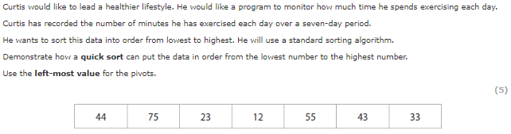
Silver 1
Exam Questions
Write below [5 mark]
Step 1/ 2 44, 75, 23, 12, 55, 43, 33 LME is 44 Step 3 23, 12, 43, 33, 44, 75, 55 Step 4 23, 12, 43, 33, 44, 75, 55 LME is 23 12, 23, 43, 33 12, 23, 33, 43 LME is 75 55, 75 Step 5 12, 23, 33, 43, 55, 75

Slide 9
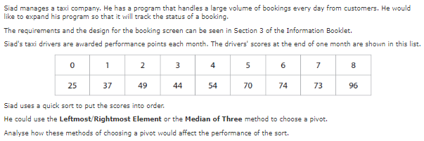
Gold 1
Exam Questions
Write below [8 mark]
A quick sort is the quickest technique however it is dependent on choosing a pivot that is not close to the lowest or largest elements in the list. The most efficient pivot will be a value somewhere in the middle of the list. The least efficient pivot will be the lowest or highest value in the list. This means choosing the first element in this list for example 25

